Slide 1
accuracy analysis of motion along circular trajectories of the manipulators built on drives with one motor and precision dual-motor DRIVES
Postgraduate student of
«Robotics and Mechatronics» Department
MSTU “STANKIN”
Kolesnichenko R. V.
Professor of
«Robotics and Mechatronics» Department
MSTU “STANKIN”
Ilyukhin Yu. V.

Slide 2
Fields of implementation of precision technological robots
Precision laser cutting, welding and marking of parts with complex shapes of surfaces;
Assembly operations, which require increased positioning accuracy of manipulator end-effector;
Robotic measurement operations of large-sized items;
Robotic milling, grinding and other technological operations, in which high motion accuracy is required to be provided at the force interaction between tool and processed part;
Technological operations where the usage of robots suggests realization of analytical programming without possibility to implement teaching methods.

Slide 3
Basic requirements to precision technological robots
Requirements to motion accuracy. Positioning error of the end-effector is within a range of 20...100 μm.
Requirements to manipulator stiffness. Elastic compliance, reduced to manipulator tool centre point (TCP), and caused by elasticity and backlash of mechanical gears, must aspire to zero in static states.
The major factors, which provoke deviations of TCP of angular manipulator with geared servo drives from a desired position, set by control program:
elasticity of mechanical gears of drives
backlash of mechanical gears of drives

Slide 4
Two types of geared servo drives, which can be used in manipulators construction:
The first type. Servo drive with traditional structure, which has one actuating motor, built as a system with inner control loops, closed by feedback position control loop of the motors shaft. Its main particularity is of the fact that control object and mechanical transmission are not included into position control loop. Elasticity and backlash of mechanical gears significantly decrease accuracy of manipulator motion.
The second type. Servo drive with two actuating motors and feedback position control loop of the control object. Its main particularity is in potentially higher accuracy, caused by direct control of control object position, also in backlash and gear elasticity active elimination and in usage of position sensor with high resolution.

Slide 5
Structure of precision dual-motor servo drive, closed by feedback position control loop of the control object.
The first motor forms servo drive, closed by feedback position control loop of the manipulator link.
So, the structure of precision drive contains:
2 actuating motors
2 position sensors
5 control loops
the second motor forms a torque loader, which acts as a controlled backlash eliminating device.

Slide 6
Research objective and tasks
Research objective – creation of procedure of evaluating motion accuracy of technological robots, built on traditional drives with one motor and on precision dual-motor drives.
Research tasks:
Definition of type and parameters of manipulator mechanism, used in research;
Definition of test trajectories and movement modes for implementing research of motion accuracy of technological robots, built on traditional drives with one motor and precision dual-motor drives;
2. Development of evaluation criteria of motion accuracy;
Development of mathematical model and program for computer simulation;
Computer simulation and detection of error dependencies on contour velocity, radius and position of the desired circular trajectory in space;
Accuracy comparison of manipulators with drives with one motor and dual-motor drives.

Slide 7
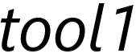

Conditions of the computer experiment, aimed at comparison between the errors of the manipulator, built on drives with one motor, and on dual-motor drives at motion along circular trajectories.
Circular trajectories, realised by manipulator in horizontal (1-3) and vertical (4-6) planes
Principal manipulators parameters
Parameter | Value
Column weight, m₀, kg | 55
Column length, l₀, m | 0.68
Weight of shoulder link, m₁, kg | 38
Length of shoulder link, l₁, m | 0.68
Weight of elbow link, m₂, kg | 35
Length of elbow link, l₂, m | 0.68
Weight off « hand» link, m₃, kg | 16
Length of hand link along OY axis, l_{tool1}, m | 0.235
Length of hand link along OZ axis, l_{tool2}, m | 0.3
Variation of contour velocity within a range from 5 to 25 mm/s;
of radius of the desired circular trajectory within a range from 10 to 150 mm.

Slide 8
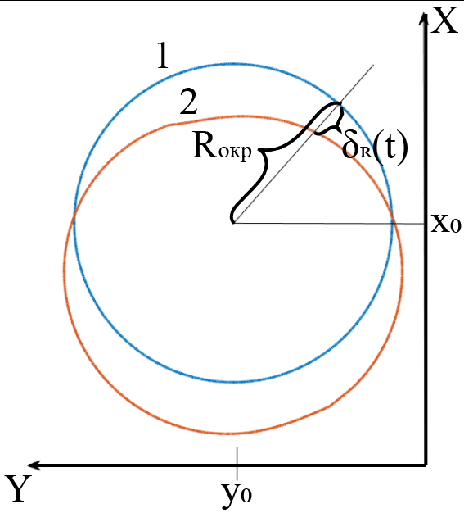


Criteria of accuracy evaluation at motion along circular trajectory
in horizontal plane
Radial mean-square deviations
Axial mean-square deviations
1 – desired trajectory
2 – actual trajectory

Slide 9
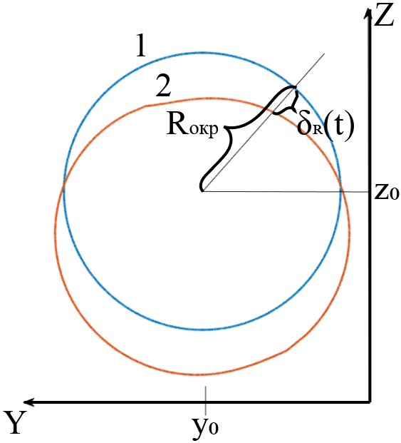
Criteria of accuracy evaluation at motion along circular trajectory
in vertical plane
Radial mean-square deviations
Axial mean-square deviations
1 – desired trajectory
2 – actual trajectory

Slide 10

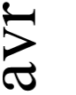
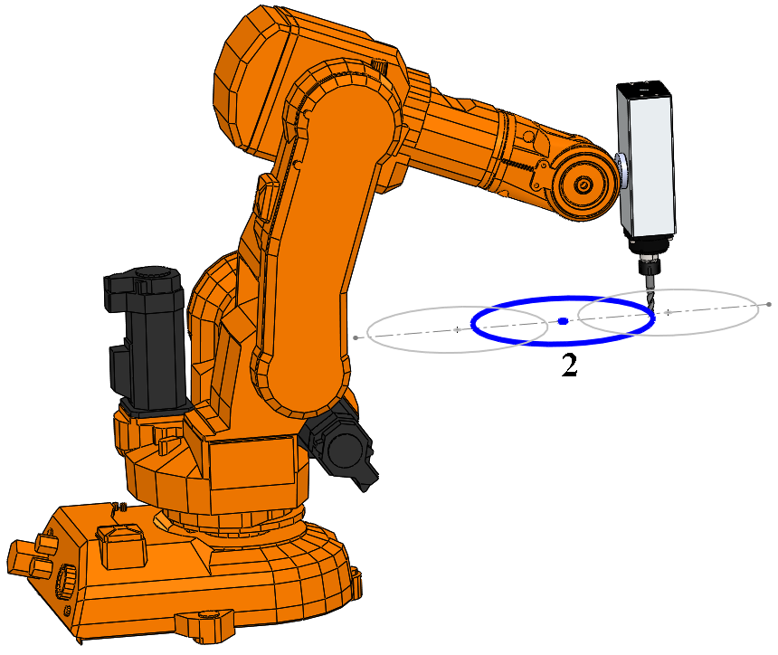

Radial and axial mean-square deviations of manipulator at motion along circular trajectory №2 in horizontal plane
for manipulator with drives with one motor
for manipulator with dual-motor drives
1 – at radius equal to 10 mm; 2 – 50 mm; 3 – 100 mm; 4 – 150 mm.
Conclusion: in these cases manipulator with precision dual-motor drives possesses significantly higher accuracy than manipulator with drives with one motor.

Slide 11


Comparison between the desired (1) and the actual (2) trajectories
a
a
a
b
b
b
1) V = 25 mm/s
R = 10 mm
2) V = 5 mm/s
R = 10 mm
3) V = 25 mm/s
R = 150 mm

Slide 12
Accuracy comparison between manipulators built on drives with one motor and dual-motor drives at motion
along circular trajectory №2 in horizontal plane
Contour velocity, mm/s | Radius, mm | Radial mean-square deviations of manipulator |  | Accuracy gain coefficient
 |  | with drives with one motor, μm | with dual-motor drives, μm
25 | 10 | 705 | 265 | 3
5 | 10 | 698 | 11 | 63
25 | 150 | 683 | 19 | 36
Conclusion: accuracy gain at the usage of manipulator with dual-motor drives at motion along circular trajectory in horizontal plane has achieved a range from almost 3 to 63 times.

Slide 13
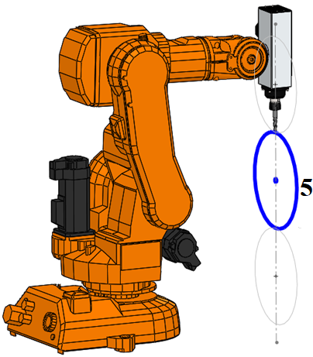
Radial and axial mean-square deviations of manipulator at motion along circular trajectory №5 in vertical plane
for manipulator with drives with one motor
for manipulator with dual-motor drives
1 – at radius equal to 10 mm; 2 – 50 mm; 3 – 100 mm; 4 – 150 mm.
Conclusion: type of dependencies of radial and axial mean-square deviations of manipulator with drives with one motor and dual-motor drives at motion along circular trajectories in vertical plane is reserved.

Slide 14
Accuracy comparison between manipulators built on drives with one motor and dual-motor drives at motion
along circular trajectory №5 in vertical plane
Contour velocity, mm/s | Radius, mm | Radial mean-square deviations of manipulator |  | Accuracy gain coefficient
 |  | with drives with one motor, μm | with dual-motor drives, μm
25 | 10 | 977 | 262 | 3.7
5 | 10 | 956 | 11 | 87
25 | 150 | 969 | 18 | 54
Conclusion: accuracy gain at the usage of manipulator with dual-motor drives at motion along circular trajectory in vertical plane has achieved a range from almost 4 to 87 times.

Slide 15
Comparison of variations of radial and axial deviations of manipulators with drives with one motor and dual-motor drives at different positions of the desired circular trajectory in space at contour velocity equal to 25 mm/s and radius 10 mm.
 | Radial mean-square deviations of manipulator |  | Axial mean-square deviations of manipulator
 | with drives with one motor, μm | with dual-motor drives, μm | with drives with one motor, μm | with dual-motor drives, μm
Motion in horizontal plane
Circular trajectory №1 | 702 | 264 | 1184 | 10
Circular trajectory №2 | 705 | 265 | 1348 | 11
Circular trajectory №3 | 699 | 266 | 1648 | 12
Difference between deviations for circular trajectories №1-3 | 3.7 | 1.6 | 464 | 2
Motion in vertical plane
Circular trajectory №4 | 731 | 257 | 1154 | 7
Circular trajectory №5 | 977 | 262 | 1089 | 5
Circular trajectory №6 | 1063 | 268 | 543 | 4
Difference between deviations for circular trajectories №4-6 | 332 | 11 | 611 | 3
Conclusion: Parameters stability of manipulator with dual-motor drives within its workspace is higher than of manipulator with drives with one motor.

Slide 16
Principal results and conclusions
The obtained estimation of motion accuracy along desired circular trajectories of technological robots with considered two types of servo drives confirms the fact that manipulators with precision dual-motor drives possess an advantage.
In all of the considered cases of the desired trajectories radial and axial mean-square deviations from the desired trajectory of manipulator with dual-motor drives are less than of manipulator with drives with one motor.
For example, at contour velocity 5 mm/s and radius of the circular trajectory 10 mm accuracy is increased up to 87 times.
Variations of the desired circular trajectory position in space weakly influence deviation of manipulator with dual-motor drives from its desired trajectory both along the radius of the circular trajectory and along the normal direction to the plane of motion.
The results of the provided research allow recommending to construct manipulators of technological robots at their analytical programming at technological operations, which require high motion accuracy, on precision dual-motor servo drives

Slide 17
Thank you for your attention!

Slide 19
The main factors, which reduce motion accuracy of technological robots-manipulators and limit their implementation:
Imperfection of mathematical models, used for kinematic control of manipulator, discrepancy between them and real manipulators;
Errors, caused by inaccurate “referencing” of manipulator coordinate system to coordinate system of the processed part;
Errors of position sensors of manipulator links;
Elastic compliance of manipulator links, defined by material properties of manipulator links and of the base, and by their geometrical properties;
Dynamic imperfection of servo drives, low dynamic stiffness and accuracy due to kinematic errors and elastic compliance of mechanical transmissions;

Slide 20
The major factors, which reduce the motion accuracy of technological manipulators and which limit their implementation:
The ways of reducing factors, which decrease robots accuracy
Imperfection of mathematical models, used for kinematic control of manipulator motion, discrepancy between them and real manipulators;
Errors, caused by inaccurate “referencing” of manipulator coordinate system to coordinate system of the processed part;
Errors of position sensors of manipulator links;
Elastic compliance of manipulator links, defined by material properties of manipulator links and of the base, and by their geometrical properties;
Dynamic imperfection of servo drives, low dynamic stiffness and accuracy due to kinematic errors and elastic compliance of mechanical transmissions;
Increase in accuracy of calibration process
Increase in sensors accuracy,
usage of precision
photoelectrical sensors
Increase in quantity of metal
of manipulation mechanism
Increase in accuracy and stiffness of robot drives

Slide 21
Increase in accuracy and stiffness of robot drives:
the usage of gearless drives
Introduction of corrective and compensative control links and loops
Correction of reference impacts, set by CNC devices
Creation of adaptive velocity (feed) control system of tool motion taking into consideration cutting forces and deviations from the desired trajectory

Slide 22
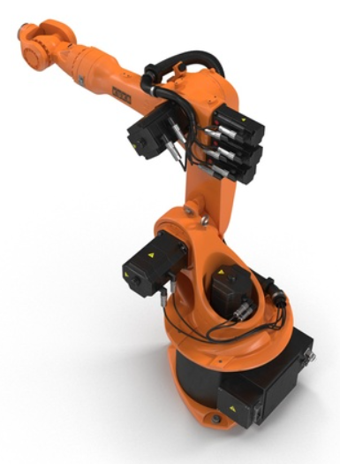
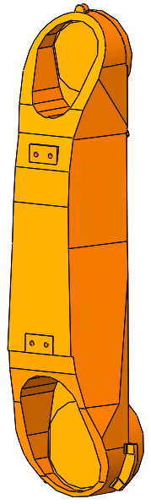
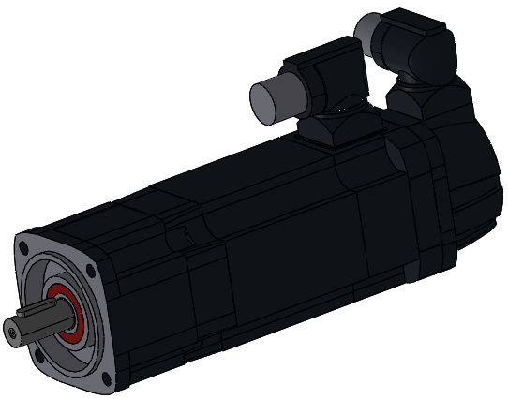
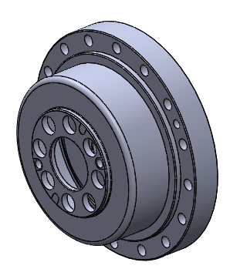
Angular manipulator
Geared servo drive of the manipulator link
manipulator link
gear
motor
position sensor of the motor shaft
The major factors, which provoke deviations of TCP of angular manipulator with geared servo drives from a desired position, set by control program:
elasticity of mechanical gears of drives
backlash of mechanical gears of drives

Slide 23
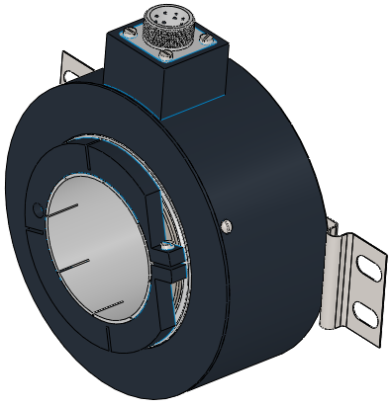
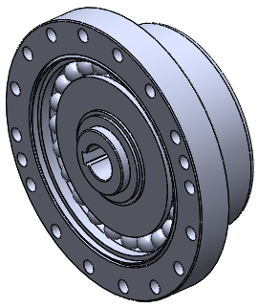
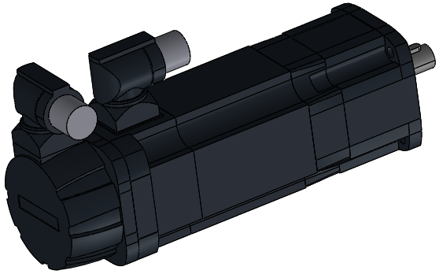
Component composition of precision dual-motor geared servo drive of manipulator link
gear of the internal servo drive
manipulator link
motor of the internal servo drive
gear of the torque generator
motor of the torque generator
Position sensor of the motor shaft of the internal servo drive
internal servo drive
position sensor of the manipulator link
torque generator

Slide 24
Parameters of dual-motor drives of manipulator links
Parameters of dual-motor drive | column, «shoulder» link | «elbow» link | «hand» link
Motor of the internal servo drive and torque generator | KEB 44.SM.203-34B5 | KEB 42.SM.203-34B5 | KEB 33.SM.203-34B5
Rated power, kW | 2,67 | 1.44 | 0.68
Rated torque, Nm | 8.5 | 4.6 | 2.15
Rated rotation frequency, min⁻¹ | 3000 | 3000 | 3000
Gear of the internal servo drive and torque generator | Harmonic Drive HFUC-58-2A-GR | Harmonic Drive HFUC-45-2A-GR | Harmonic Drive HFUC-20-2A-GR
Gear ratio coefficient | 120 | 120 | 80
Stiffness coefficient of gear, Nm/rad | 710000 | 330000 | 29000
Backlash, arc. min. | 1 | 1 | 1
PWM frequency, kHz | 16 | 16 | 16
Resolver resolution (on motor shaft), discrete/rev. | 2047 | 2047 | 2047
Encoder resolution (on link shaft), discrete/rev. | 250000 | 250000 | 250000
Torque of the torque generator, Nm | 20.7 | 9.6 | 0.8
Parameters of drives with one motor of manipulator links
Parameters of drive with one motor | column, «shoulder» link | «elbow» link | «hand» link
Motor of the internal servo drive | KEB 44.SM.203-34B5 | KEB 44.SM.203-34B5 | KEB 33.SM.203-34B5
Gear of the internal servo drive | Harmonic Drive HFUC-58-2A-GR | Harmonic Drive HFUC-40-2A-GR | Harmonic Drive HFUC-20-2A-GR

Slide 25
– summary radial deviation of manipulator
– deviations, caused by dynamics of drive
– deviations, caused by backlash and elasticity of gears
Summary radial deviation of manipulator with drives with one motor
Summary radial deviation of manipulator with dual-motor drives

Slide 26
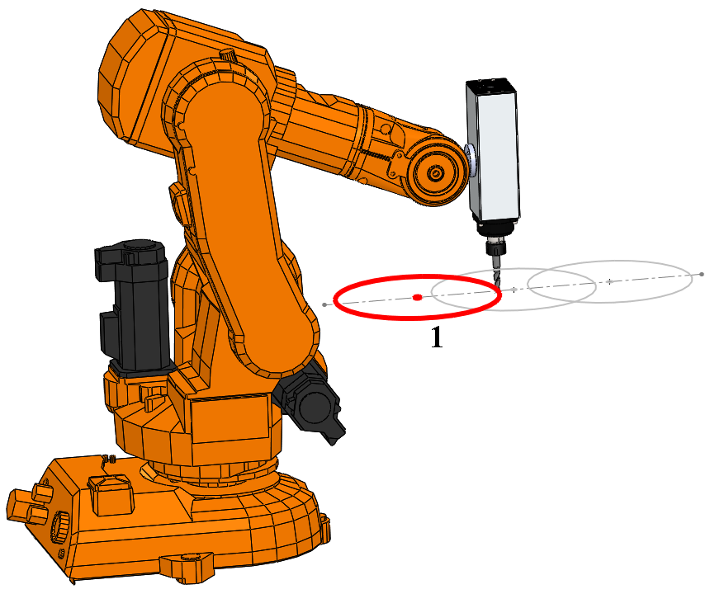
Radial and axial mean-square deviations of manipulator at motion along circular trajectory №1 in horizontal plane
for manipulator with drives with one motor
for manipulator with dual-motor drives
1 – at radius equal to 10 mm; 2 – 50 mm; 3 – 100 mm.

Slide 27
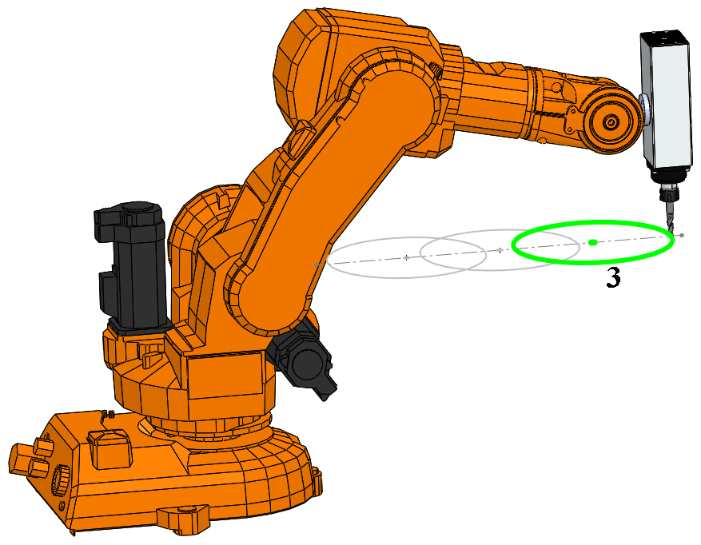
Radial and axial mean-square deviations of manipulator at motion along circular trajectory №3 in horizontal plane
for manipulator with drives with one motor
for manipulator with dual-motor drives
1 – at radius equal to 10 mm; 2 – 50 mm; 3 – 100 mm ; 4 – 150 mm.

Slide 28
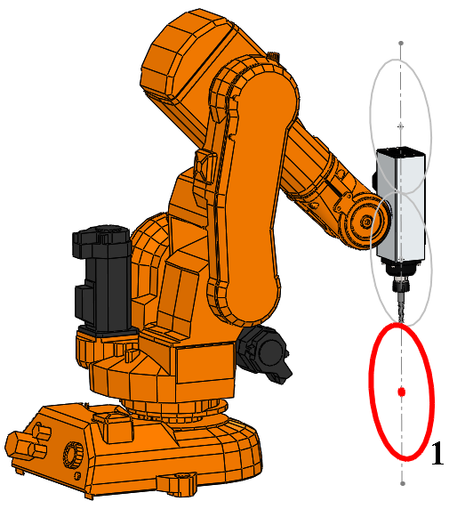
Radial and axial mean-square deviations of manipulator at motion along circular trajectory №4 in vertical plane
for manipulator with drives with one motor
for manipulator with dual-motor drives
1 – at radius equal to 10 mm; 2 – 50 mm; 3 – 100 mm ; 4 – 150 mm.

Slide 29
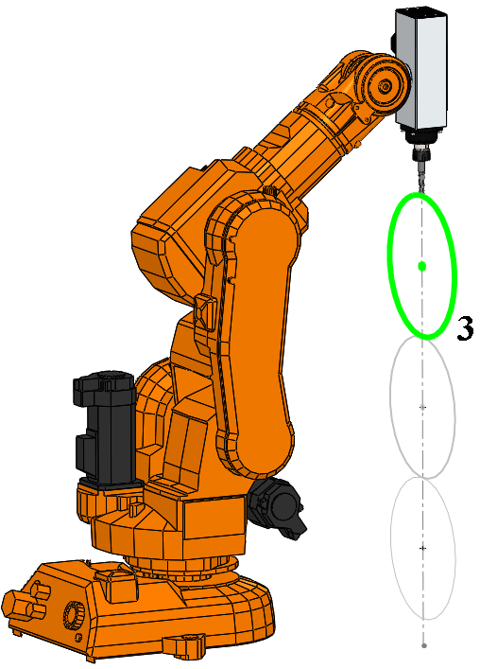
Radial and axial mean-square deviations of manipulator at motion along circular trajectory №6 in vertical plane
for manipulator with drives with one motor
for manipulator with dual-motor drives
1 – at radius equal to 10 mm; 2 – 50 mm; 3 – 100 mm ; 4 – 150 mm.

Slide 31
An increase in accuracy and performance of robotic milling
The authors:
professor Ilyukhin Yu. V.,
PhD student Kolesnichenko R. V.
Department of «Robotics and mechatronics»
MSTU «Stankin»

Slide 32
The advantages of robotic milling
Large workspace of manipulators
The processed part may have complex surface shape
The equipment costs are significantly less than for processing parts by machine tools
Less volume of metal for the equipment is required as compared with machine tools
High levels of flexibility, adaptability and programmability of robotic system
It is easy to introduce additional axes in the system in order to increase the workspace

Slide 33
Major problems of robotic milling
Low stiffness of manipulator mechanism
Low accuracy of manipulator mechanism
A reduction in feed velocity promotes increase in accuracy, but leads to decrease in performance
Chatter and vibrations, which arise during the milling process

Slide 34
Accuracy and performance requirements to robotic milling
The performance of robotic milling is
where – cutting depth; – width of the removed layer; – velocity of longitudinal feed of tool (contour velocity).
The cutting force is often calculated by empirical formulas:
where – proportional coefficient, which takes into account material properties of the workpiece and the tool, diameter , number of teeth , rotation frequency and coefficient of wear of the milling cutter; – power exponents.

Slide 35
Accuracy and performance requirements to robotic milling
Accuracy and performance of milling process are interconnected.
An increase in performance is possible until the accuracy requirement of milling is met
– deviation of tool,
measured normal to the desired trajectory of its movement;
– admissible deviation of tool.

Slide 36
The major factors, which reduce the accuracy of movements of technological manipulators and which limit their implementation:
Imperfection of mathematical models, used for kinematic control of manipulator movements, discrepancy between them and real manipulators;
Elastic compliance of manipulator links, defined by material properties of manipulator links and its base, and also by their geometrical features
Dynamic imperfection of servo drives, low dynamic stiffness and accuracy due to kinematic errors and elastic compliance of gears;
Dynamic stiffness, provided by position control system of manipulator;
Errors of position sensors of manipulator links;
Errors, caused by inaccurate linkage of manipulator coordinate system to coordinate system of the part which is being processed.
The ways of reducing factors, which decrease robots accuracy
Increase in accuracy of calibration process;
Variations in mechanical components of robot. Increase in quantity of metal of manipulation mechanism and application of other technological and design solutions, which may cause significant increase in costs of robotic system;
Increase in accuracy and stiffness of robot drives by the following methods:
the usage of gearless drives (machine tool industry);
Introduction of corrective and compensative control links and loops;
Correction of reference impacts, set by CNC devices (machine tool industry).

Slide 37
An idea of constructing manipulator, which realizes robotic milling, on dual motor servo drives
Structure of precision servo drive with two interactively controlled motors:
The first motor
is a part of the primary servo drive, closed by a position control loop of manipulator link.
The structure of precision drive contains:
2 motors
2 position sensors
5 control loops
The second motor
is a loader, which generates torque, counteracting the primary motor.
The application of drives with such structure is accompanied by the following factors:
increase in accuracy of robot motion along the desired trajectory
significant increase in stiffness
appearance of intensive self-oscillations due to elastic gear with backlash, which is included into control loop
appearance of relatively low-frequent low damped oscillations in electromechanical subsystems

Slide 38
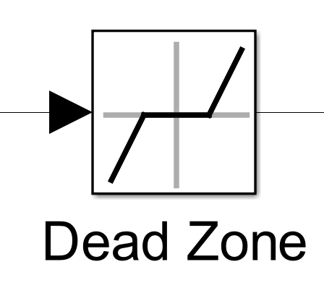
The condition of appearance of self-oscillations
Drive mathematical model
Backlash of gear
Linearized equation of mechanical transmission:
where
varies from 0 to 1
when
There are no structures and control algorithms which can guarantee the absence of self-oscillations without the loader
if
it is possible to get a drive with no self-oscillations

Slide 39
The influence of the external moment impact
The first task consists in selecting the torque of the drive of the loader so that variations of the coefficient q(A) are limited. So,
When the external moment impact results in the fact that the properties of the mechanical transmission with backlash approach the properties of the backlash-free transmission
the drive has no static error, caused by elasticity and backlash of mechanical transmission
High accuracy of movements of control object
Static stiffness of the drive tends to infinity at the constant external torque.
The dynamic stiffness of the servo drive at the action of the varying moment of external forces can be increased as a result of the rational choice of the structure and the values of the controllers parameters.

Slide 40
The danger of appearance of low-damped oscillations.
Mechanical subsystem of the drive
Electromechanical subsystem of the drive
The internal digital servo drive and the mechanical subsystem are dynamically interconnected and they form a unified dynamical electromechanical subsystem of the precision drive. The motor shaft of the internal drive is shifted under the action of the moment of reaction forces from the elastic gear side. Therefore, the value of the resulting stiffness of the electromechanical subsystem is reduced, and this fact causes the reduction in the resonant frequency of the electromechanical subsystem.
Low-damped oscillations may appear

Slide 41
Taking measures for damping oscillations in order to increase performance and accuracy of the servo drive
Introduction of corrective velocity feedback loops of manipulator links to the inputs of internal servo drives
This fact leads to:
And the cutoff frequency of the opened precision drive
>
It is advisable to adjust controllers of the internal drive so that their cutoff frequency in the opened position control loop is close to the minimum value of the frequency of natural oscillations of the mechanical subsystem:
In order to increase dynamic stiffness and accuracy of the drive it is also feasible to increase the following parameters:

Slide 42
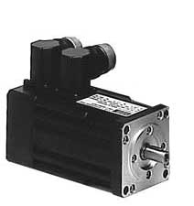
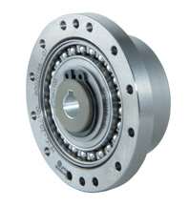
Parameter of drive | Parameter value | Размерность
Rated speed | 4000 | rpm
Rated torque | 2 | N*m
Inertia moment of the rotor | 5.7*10⁻⁵ | kg*m²
EMF coefficient of motor | 0.577 | Vs
Electromagnetic time constant | 3.2 | ms
Winding resistance | 9.2 | Ohm
Gear ratio | 100
Stiffness coefficient of gear | 250000 | Nm/rad
Backlash | 1 | arc min
Coefficient of viscous friction in gear | 500 | Nms/rad
Constant moment of the loader | 45 | N*m
Division value of the binary code LSB of the position sensor of the control object | 1.75*10⁻⁶ | rad
PWM frequency in power converter | 20 | kHz
Resolution of the position sensor of the motor shaft | 5000 | discrete per revolution
Cutoff frequency of the internal servo drive opened by position control loop | 105 | rad/s
Inertia moment of the control object | 10 | kg*m²
Motor B3.SM.000-4400 by КЕВ
Precision waveform gear HFUC-2A-50 by Harmonic Drive

Slide 43
The results of the computer simulation of the precision drive
1) The object is driven only by the internal drive, closed by a position control loop of the motor shaft
The transient process of position control of the control object by the internal drive without the corrective loop
Conclusion: low-damped electromechanical subsystem does not allow us to significantly increase accuracy of the servo drive, as it obliges us to limit its cutoff frequency.

Slide 44
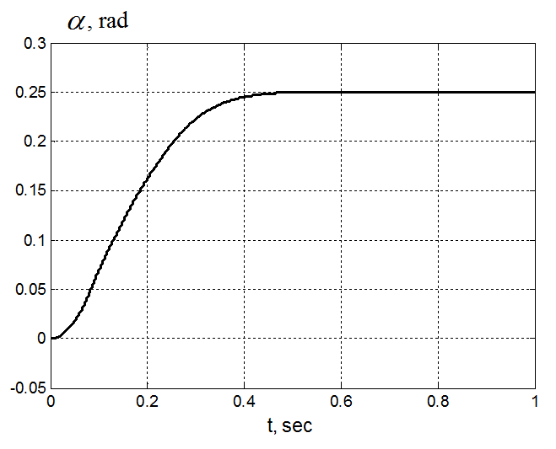
2) System response to the reference impact rad of the control object angle at consideration of the precision servo drive closed by position control loop
The transient process of position control of the control object by the precision drive without the corrective loop
The transient process of position control of the control object by the precision drive with the velocity corrective loop
Conclusion: introduction of corrective velocity feedback loop of the control object allows us to completely damp oscillations, caused by elasticity of the gear.

Slide 45
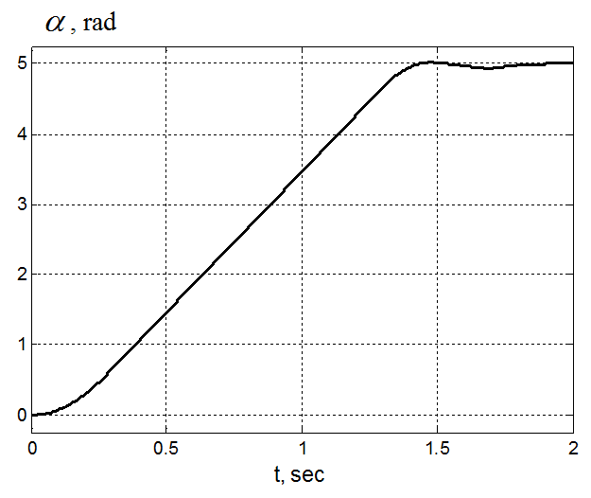
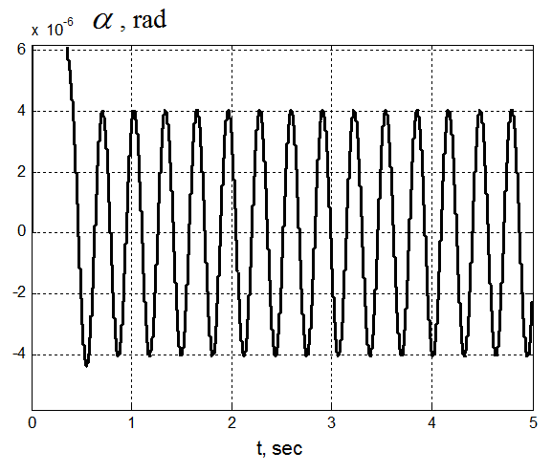
3) System response to the step impact
4) System response to the harmonic disturbance impact
A response of the precision drive to large initial error, when there is a velocity corrective feedback control loop of the control object and a nonlinear correction of the input impact of the position controller
The error of the drive at harmonic variation of the moment of external forces with magnitude 1 Nm and frequency 20 rad/s
Conclusion: the suggested structure of servo drive allows us to significantly increase dynamic stiffness and controlled damping of control object oscillations. This kind of drive can be related to the class of high precision servo drives and it can be recommended for constructing technological robots.

Slide 46
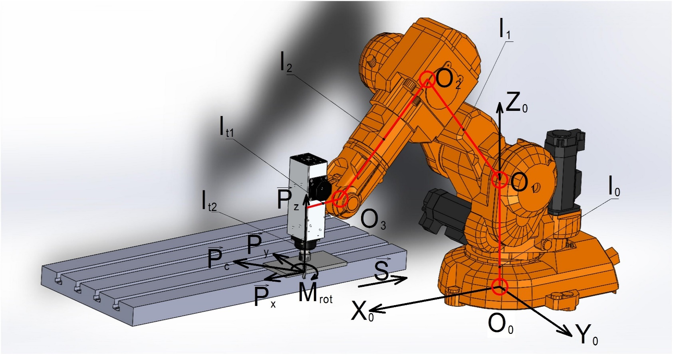
The conditions of the computing experiment on comparison of the errors arising at robotic milling process implemented by manipulator, built on dual motor drives and manipulator, built on traditional drives with one motor
1. Dynamic model of the manipulator, designed to perform cylindrical up-milling of the lateral surface of the workpiece
Manipulator parameters
Parameter | Value
Mass of the «shoulder» link, m₁, kg | 38
Length of the «shoulder» link, l₁, m | 0.68
Mass of the «elbow» link with load, m₂, kg | 35
Length of the «elbow» link, l₂, m | 0.68
l₀, m | 0.68
l_{t1}, m | 0.1
l_{t2}, m | 0.2
There is an admission that the links of manipulator mechanism are absolutely rigid. The milling process occurs when the configuration of the manipulator, characterized by the angle between the "shoulder" and "elbow" links, is approximately equal to 45°.

Slide 47
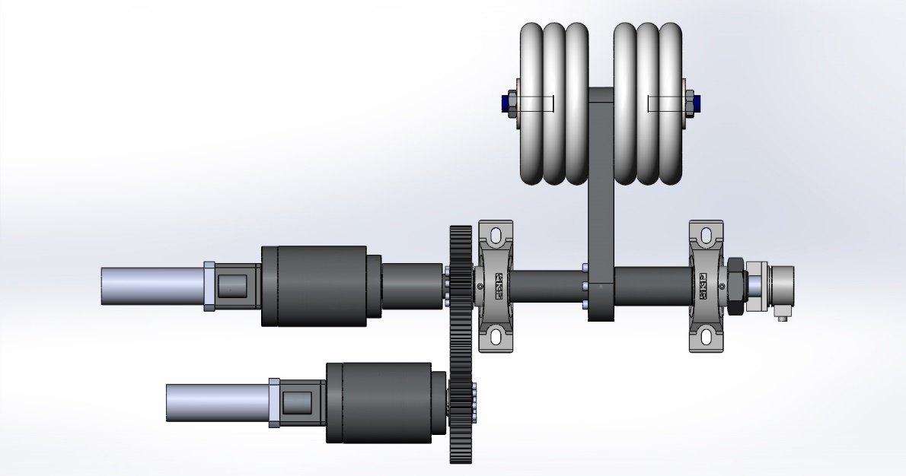
2. Parameters of dual-motor drives (motors and gears) of the «shoulder», the «elbow» and the column links of robot.
Parameters of dual motor drive | The drive of the «shoulder» and column links |  | The drive of the «elbow» link
 | The value of the parameter | Dimension | The value of the parameter | Dimension
Model of the motor of internal servodrive | KEB 44.SM.203-34B5 | - | KEB 42.SM.203-34B5 | -
Rated power | 2,67 | kW | 1.44 | kW
Rated torque | 8.5 | Nm | 4.6 | Nm
Rated speed | 3000 | min⁻¹ | 3000 | min⁻¹
Model of the gear of internal servodrive | Harmonic Drive HFUC-50-2A-GR | - | Harmonic Drive HFUC-40-2A-GR | -
Gear ratio | 120 | - | 120 | -
Stiffness coefficient of gear | 400000 | Nm/rad | 130000 | Nm/rad
Natural frequency of mechanical subsystem | 43 | Rad/s | 69 | Rad/s
Backlash | 1 | arc min | 1 | arc min
PWM frequency of the power converter | 16 | kHz | 16 | kHz
Resolution of the resolver (of the motor shaft) | 2047 | discrete/rev. | 2047 | discrete/rev.
Resolution of the encoder (of the manipulator link) | 250000 | discrete/rev. | 250000 | discrete/rev.
Loader parameters
 | The drive of the «shoulder» and column links | The drive of the «elbow» link
Model of the motor of internal servodrive | KEB 44.SM.203-34B5 | KEB 42.SM.203-34B5
Model of the gear of internal servodrive | Harmonic Drive HFUC-50-2A-GR | Harmonic Drive HFUC-40-2A-GR
Gear ratio | 120 | 120
The moment, generated by the loaders, Nm | 11.6 | 3.8

Slide 48
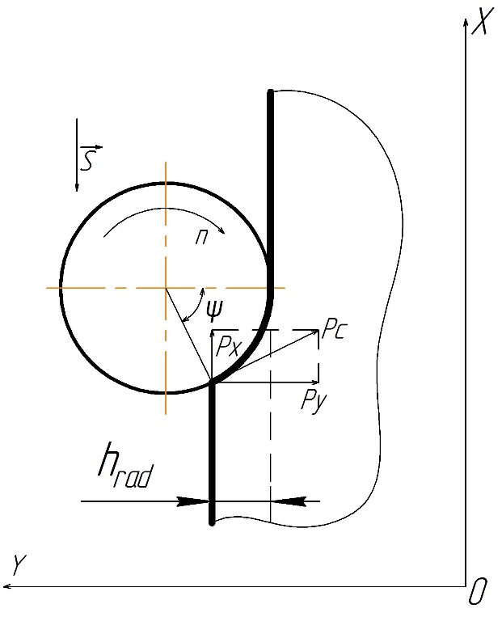
3. Parameters of drives with one motors (motors and gears) of the «shoulder» and the «elbow» links of robot.
Parameters of drive with one motor | The drive of the «shoulder» and column links |  | The drive of the «elbow» link
 | The value of the parameter | Dimension | The value of the parameter | Dimension
Model of the motor of internal servodrive | KEB 44.SM.203-34B5 | - | KEB 42.SM.203-34B5 | -
Model of the gear of internal servodrive | Harmonic Drive HFUC-50-2A-GR | - | Harmonic Drive HFUC-40-2A-GR | -
4. Cutting parameters
The empirical formula for determining the peripheral cutting force
Parameters | designation | Value
Material of the part | - | D16T / 2024 (AlCu4Mg1)
Number of teeth of the milling cutter | z | 5
Diameter of the milling cutter, mm | D | 6
Length of the working part of the cutter, mm | B | 12
Angle of the helical chip grooves | ⍵ | 20°
Rotation frequency of the tool, rpm | n | 10000
Cutting width, mm | - | 12
Trajectory length, mm | - | 200
Cp – empirical coefficient, which is chosen depending on the type of milling cutter and the material of the cutting tool;
Kmp – the correction factor which takes into account the influence of the quality of aluminum alloys on the force dependence;
h – depth of cutting, mm;
S – feed velocity, m/s.

Slide 49
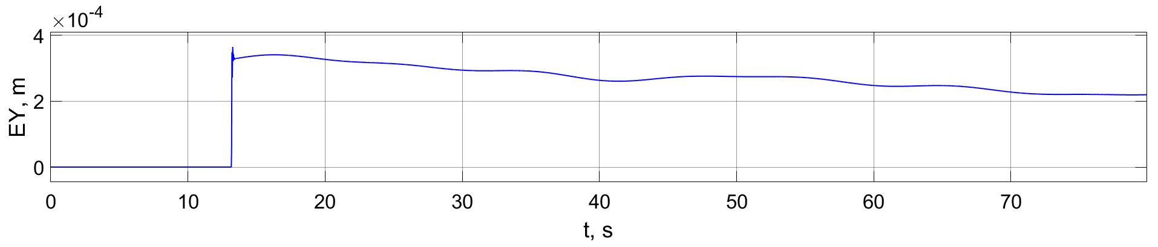
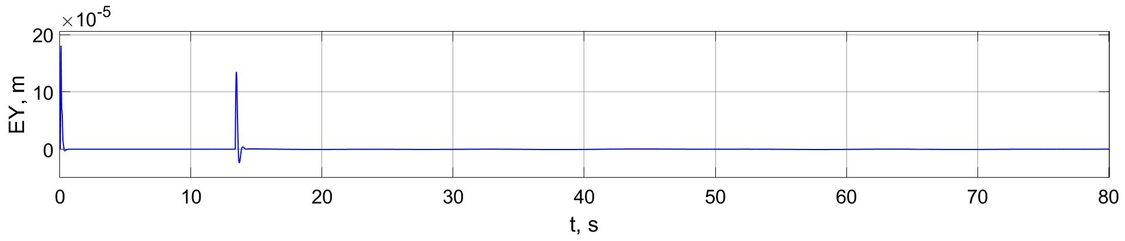
4. The results of the computing experiment (simulation). The transient processes.
The error of the manipulator with drives with one motor, measured along OY axis,
taking into account surface roughness of the workpiece.
The error of the manipulator with dual motor drives, measured along OY axis, taking into account surface roughness of the workpiece.

Slide 50
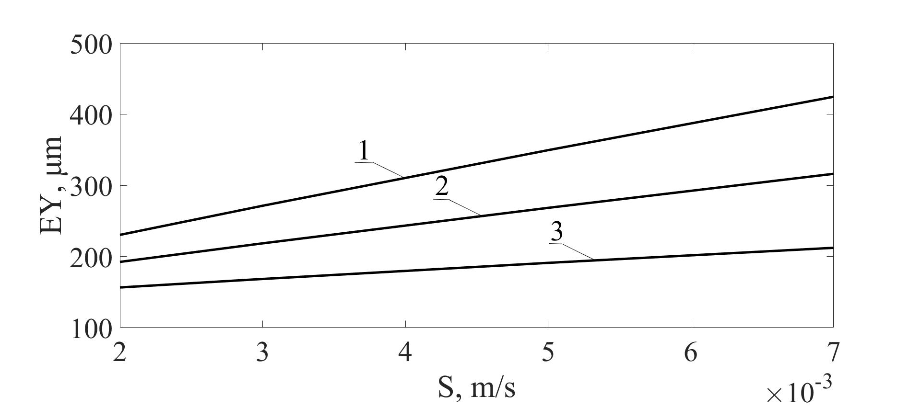
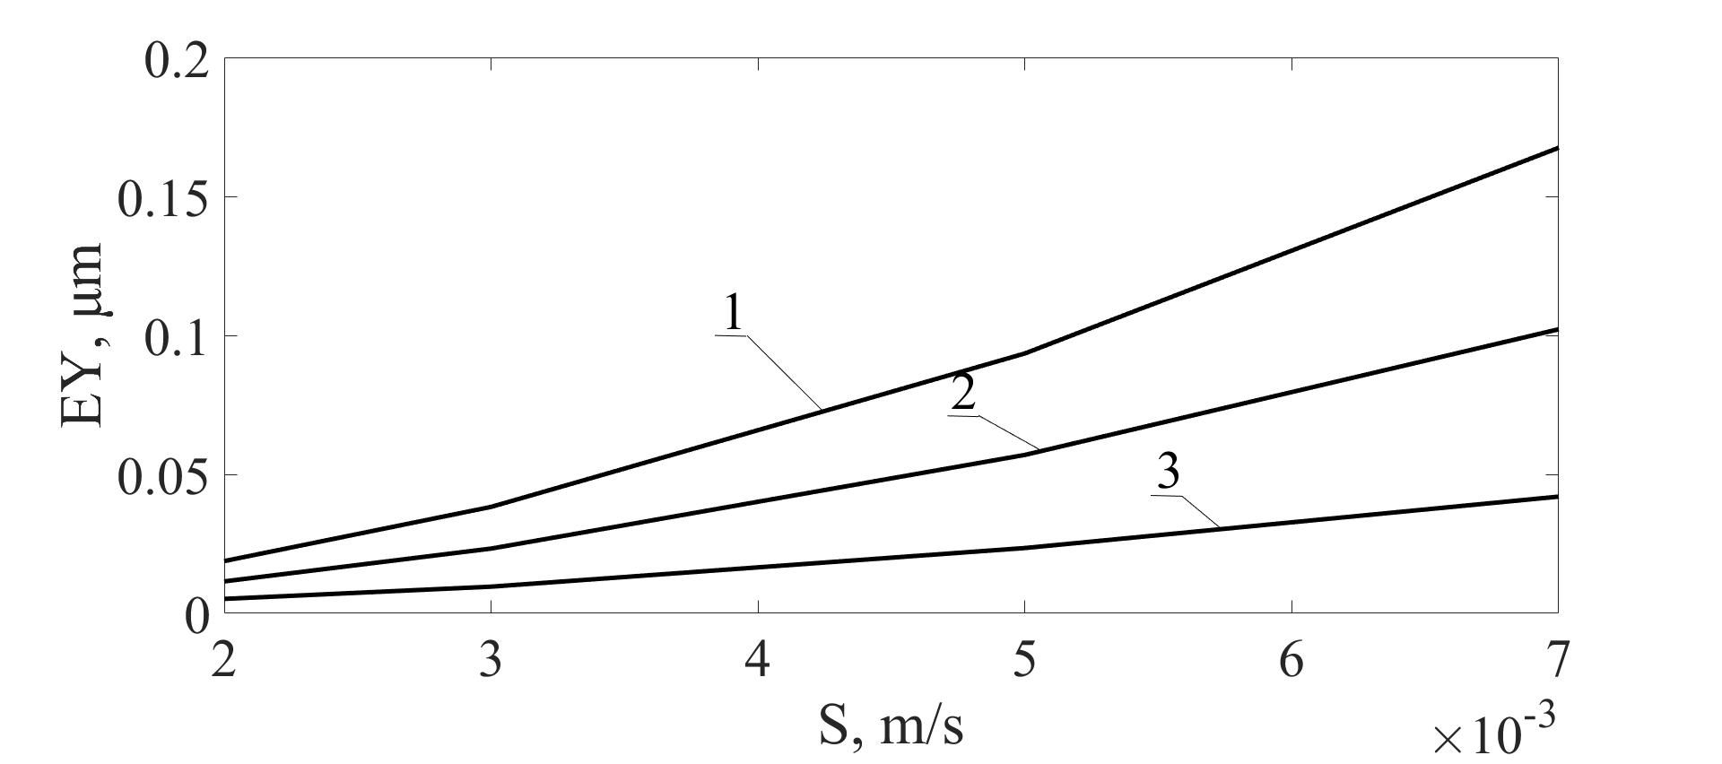
5. Changes of manipulator deviation from the trajectory at different cutting parameters
The dependence of the deviation from the trajectory of the manipulator built on drives with one motor at different values of the cutting depth and feed velocity: 1 – at h = 1.5 mm, 2 – ath = 1 mm, 3 – at h = 0.5 mm.
The dependence of the deviation from the trajectory of the manipulator built on dual motor drives at different values of the cutting depth and feed velocity : 1 – at h = 1.5 mm, 2 – ath = 1 mm, 3 – at h = 0.5 mm.
The average value of the absolute value of the deviation of tool from the trajectory, measured along the normal direction to the processed surface.

Slide 51
6. Variations of the linear stiffness value of manipulator, measured along the normal direction to the processed surface, at different cutting parameters and at system nonlinearities
– cutting force component, acting along the direction normal to the processed surface;
– deviation of the manipulator tool from its desired position measured along the direction normal to the processed surface.
S, m/s | Linear stiffness of the manipulator along OY axis, N/m
 | at h = 0.5 mm |  | at h = 1 mm |  | at h = 1.5 mm
 | manipulator with dual motor drives | manipulator with one motor drive | manipulator with dual motor drives | manipulator with one motor drive | manipulator with dual motor drives | manipulator with one motor drive
0.002 | 141330000 | 101840 | 288370000 | 175270 | 452550000 | 227900
0.003 | 95870000 | 131000 | 195530000 | 214580 | 306420000 | 269240
0.005 | 58380000 | 176100 | 119020000 | 268690 | 186300000 | 321740
0.007 | 41020000 | 210810 | 83840000 | 305760 | 131360000 | 355180

Slide 52
Conclusions of the simulation results
In order to increase accuracy and performance of robotic milling technological robots based on dual motor servo drives, closed by position control loops of the manipulator links, can be used.
In order to improve the dynamic parameters of such robots it is advisable to apply impedance control, implemented at the introduction of velocity corrective control loops of manipulator links.
The proposed solution allows us to significantly increase the static and dynamic stiffness of the robot by control means without any changes in mechanical robot components. This fact gives an opportunity to weaken the influence of cutting forces on tool deviation from the desired trajectory, and to improve the performance of robotic milling on this basis.
The results of computing experiments have shown a considerable increment of accuracy and tenfold gain in performance of the suggested solution in comparison with the robot with traditional structure of servo drives, closed by position control loops of their motor shafts.

